Slide 1

Functional Data Analysis Regression on global ozone fluctuation
Li Sun
Adviser: Dr. Jingyong Su
Committee member: Dr. Fangyuan Zhang

Slide 2
Index
Background of FDA
Ozone Data and Covariates Data and Data processing
Functional data presentation
Smoothing
Registration by SRSF
Description statistics
Linear Regression for Functional Responses
Summary
Reference

Slide 3
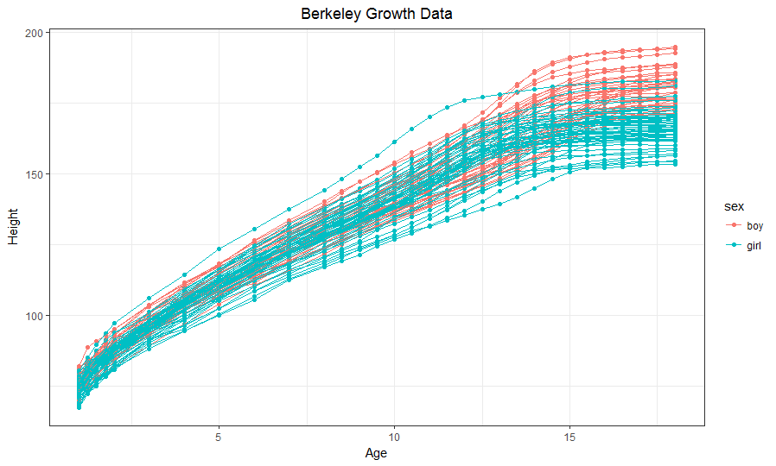
What is functional data analysis
Ex. Berkeley growth data
Functional data is ‘extension’ of multivariate case with correlated error
FDA is different by using ‘smoothing’ extensively (non-parametric)
Less assumptions
Study all derivatives
Reflect true mechanism of data

Slide 4
Anatomy
Assumptions
Underlying functions is continuous and smooth (Ds exist)
y(j) and y(j+1) are linked to some extent. Or treat data as multivariate
Feature
levels, crossing, peaks/valleys
Data Resolution (n) and Functional dimensionality
Total amount of information required to define it as demanded
Size (N)

Slide 5
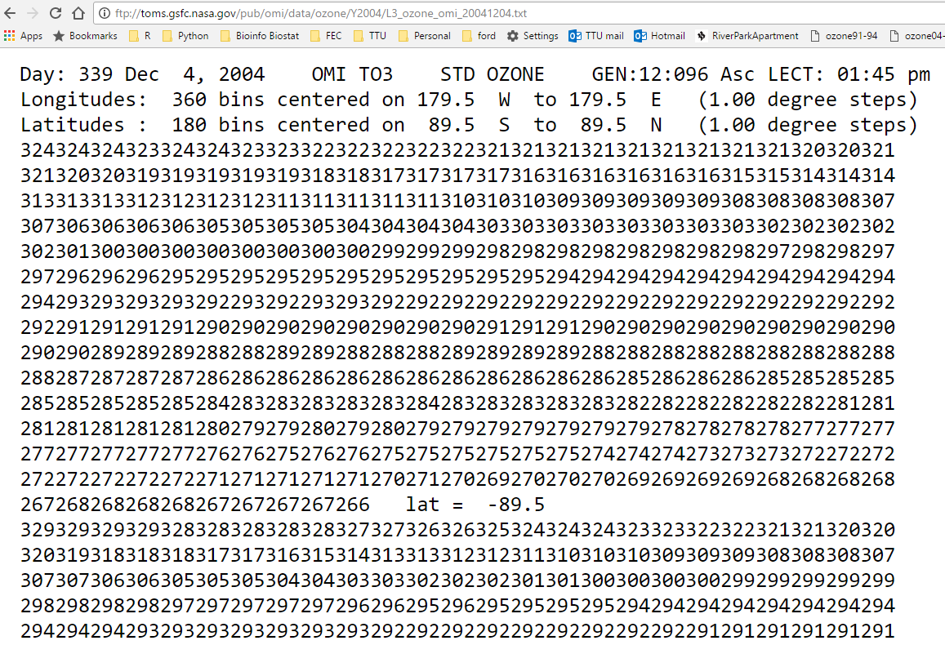
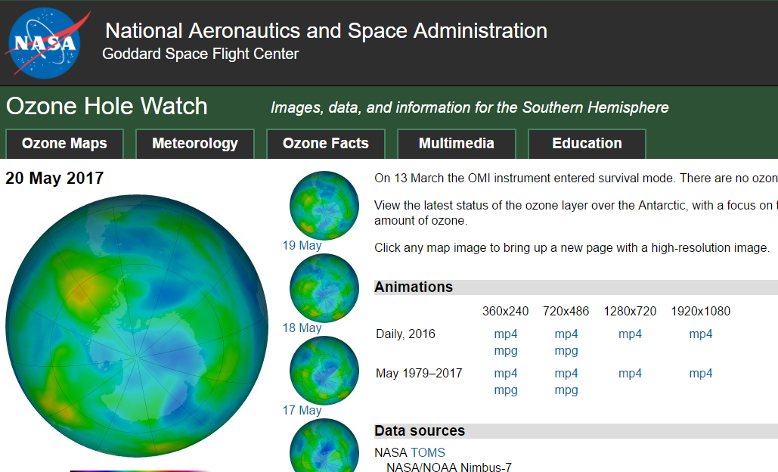
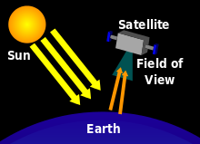
Ozone Data
Notes:
Ozone watch program
Data are collected by satellite
Ozone is a colorless gas. Chemically, ozone is very active; it reacts readily with a great many other substances. Near the Earth’s surface, those reactions cause rubber to crack, hurt plant life, and damage people’s lung tissues. But ozone also absorbs harmful components of sunlight, known as “ultraviolet B”, or “UV-B”. High above the surface, above even the weather systems, a tenuous layer of ozone gas absorbs UV-B, protecting living things below.
The Dobson Unit (DU) is the unit of measure for total ozone. If you were to take all the ozone in a column of air stretching from the surface of the earth to space, and bring all that ozone to standard temperature (0 °Celsius) and pressure (1013.25 millibars, or one atmosphere, or “atm”), the column would be about 0.3 centimeters thick. Thus, the total ozone would be 0.3 atm-cm. To make the units easier to work with, the “Dobson Unit” is defined to be 0.001 atm-cm. Our 0.3 atm-cm would be 300 DU.
Data source
TOMS(Total Ozone Mapping Spectrometer)
The Ozone Mapping and Profiler Suite (OMPS) is the next generation of back-scattered UltraViolet (BUV) radiation sensors

Slide 6
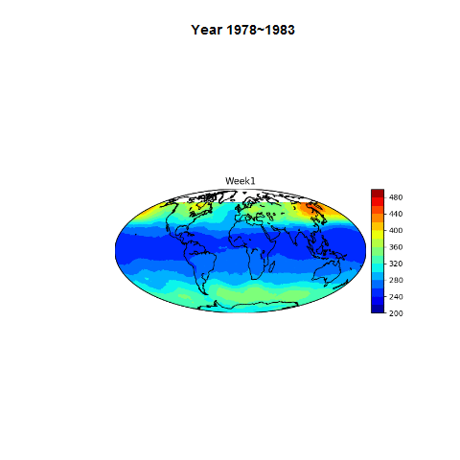
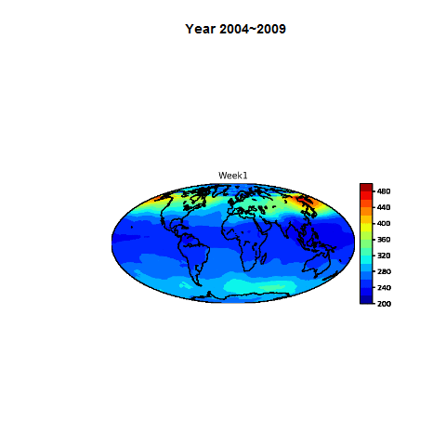
Data visualization

Slide 7
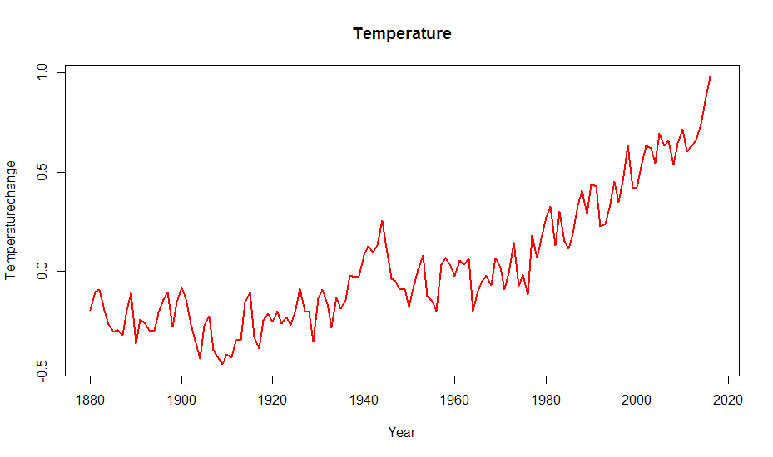
Covariates: Temperature
From GISTEMP
From stations roughly 1200km apart
Yearly average used as scaler
Notes:
Goddard Institute for Space Studies (GISS) Surface Temperature Analysis (GISTEMP) is an estimate of global surface temperature change. Graphs and tables are updated around the middle of every month using current data files from NOAA GHCN v3 (meteorological stations), ERSST v4 (ocean areas), and SCAR (Antarctic stations), combined as described in our December 2010 publication (Hansen et al. 2010). These updated files incorporate reports for the previous month and also late reports and corrections for earlier months.
Deviation from 1951-1980 means

Slide 8
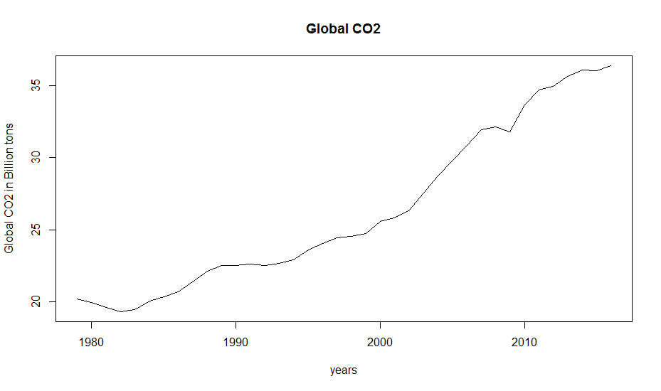
Covariates: CO₂
Emission Database for Global Atmospheric Research (EDGAR), release version 4.3.2. http://edgar.jrc.ec.europe.eu, 2016 forthcoming
Global CO2 emissions from fossil fuel use and cement production 1970-2015 in mtons
207 Country total
2016 data is projected by time series model

Slide 9
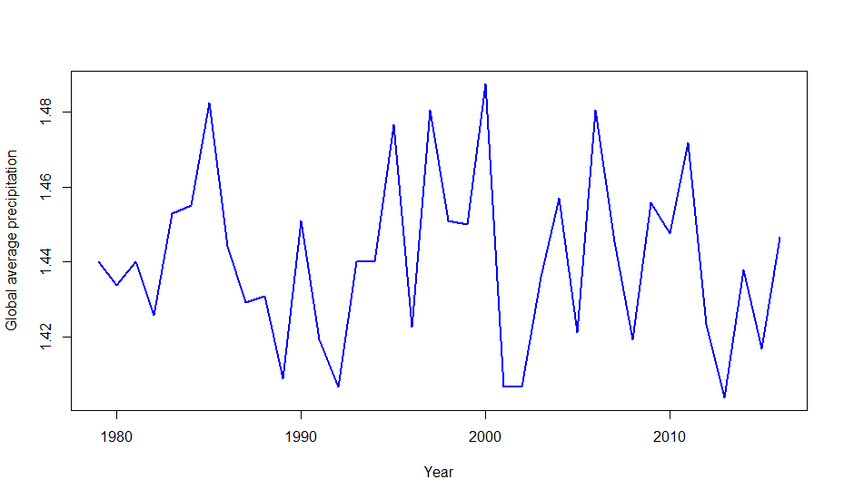
Covariates: Precipitation
Data source: Advanced Hydrologic Prediction Service (National Weather Service)
Median is taken from monthly grid data (144 by 72)
https://water.weather.gov/precip/download.php
Notes:
The precipitation data are quality-controlled, multi-sensor (radar and rain gauge) precipitation estimates obtained from National Weather Service (NWS) River Forecast Centers (RFCs).

Slide 10
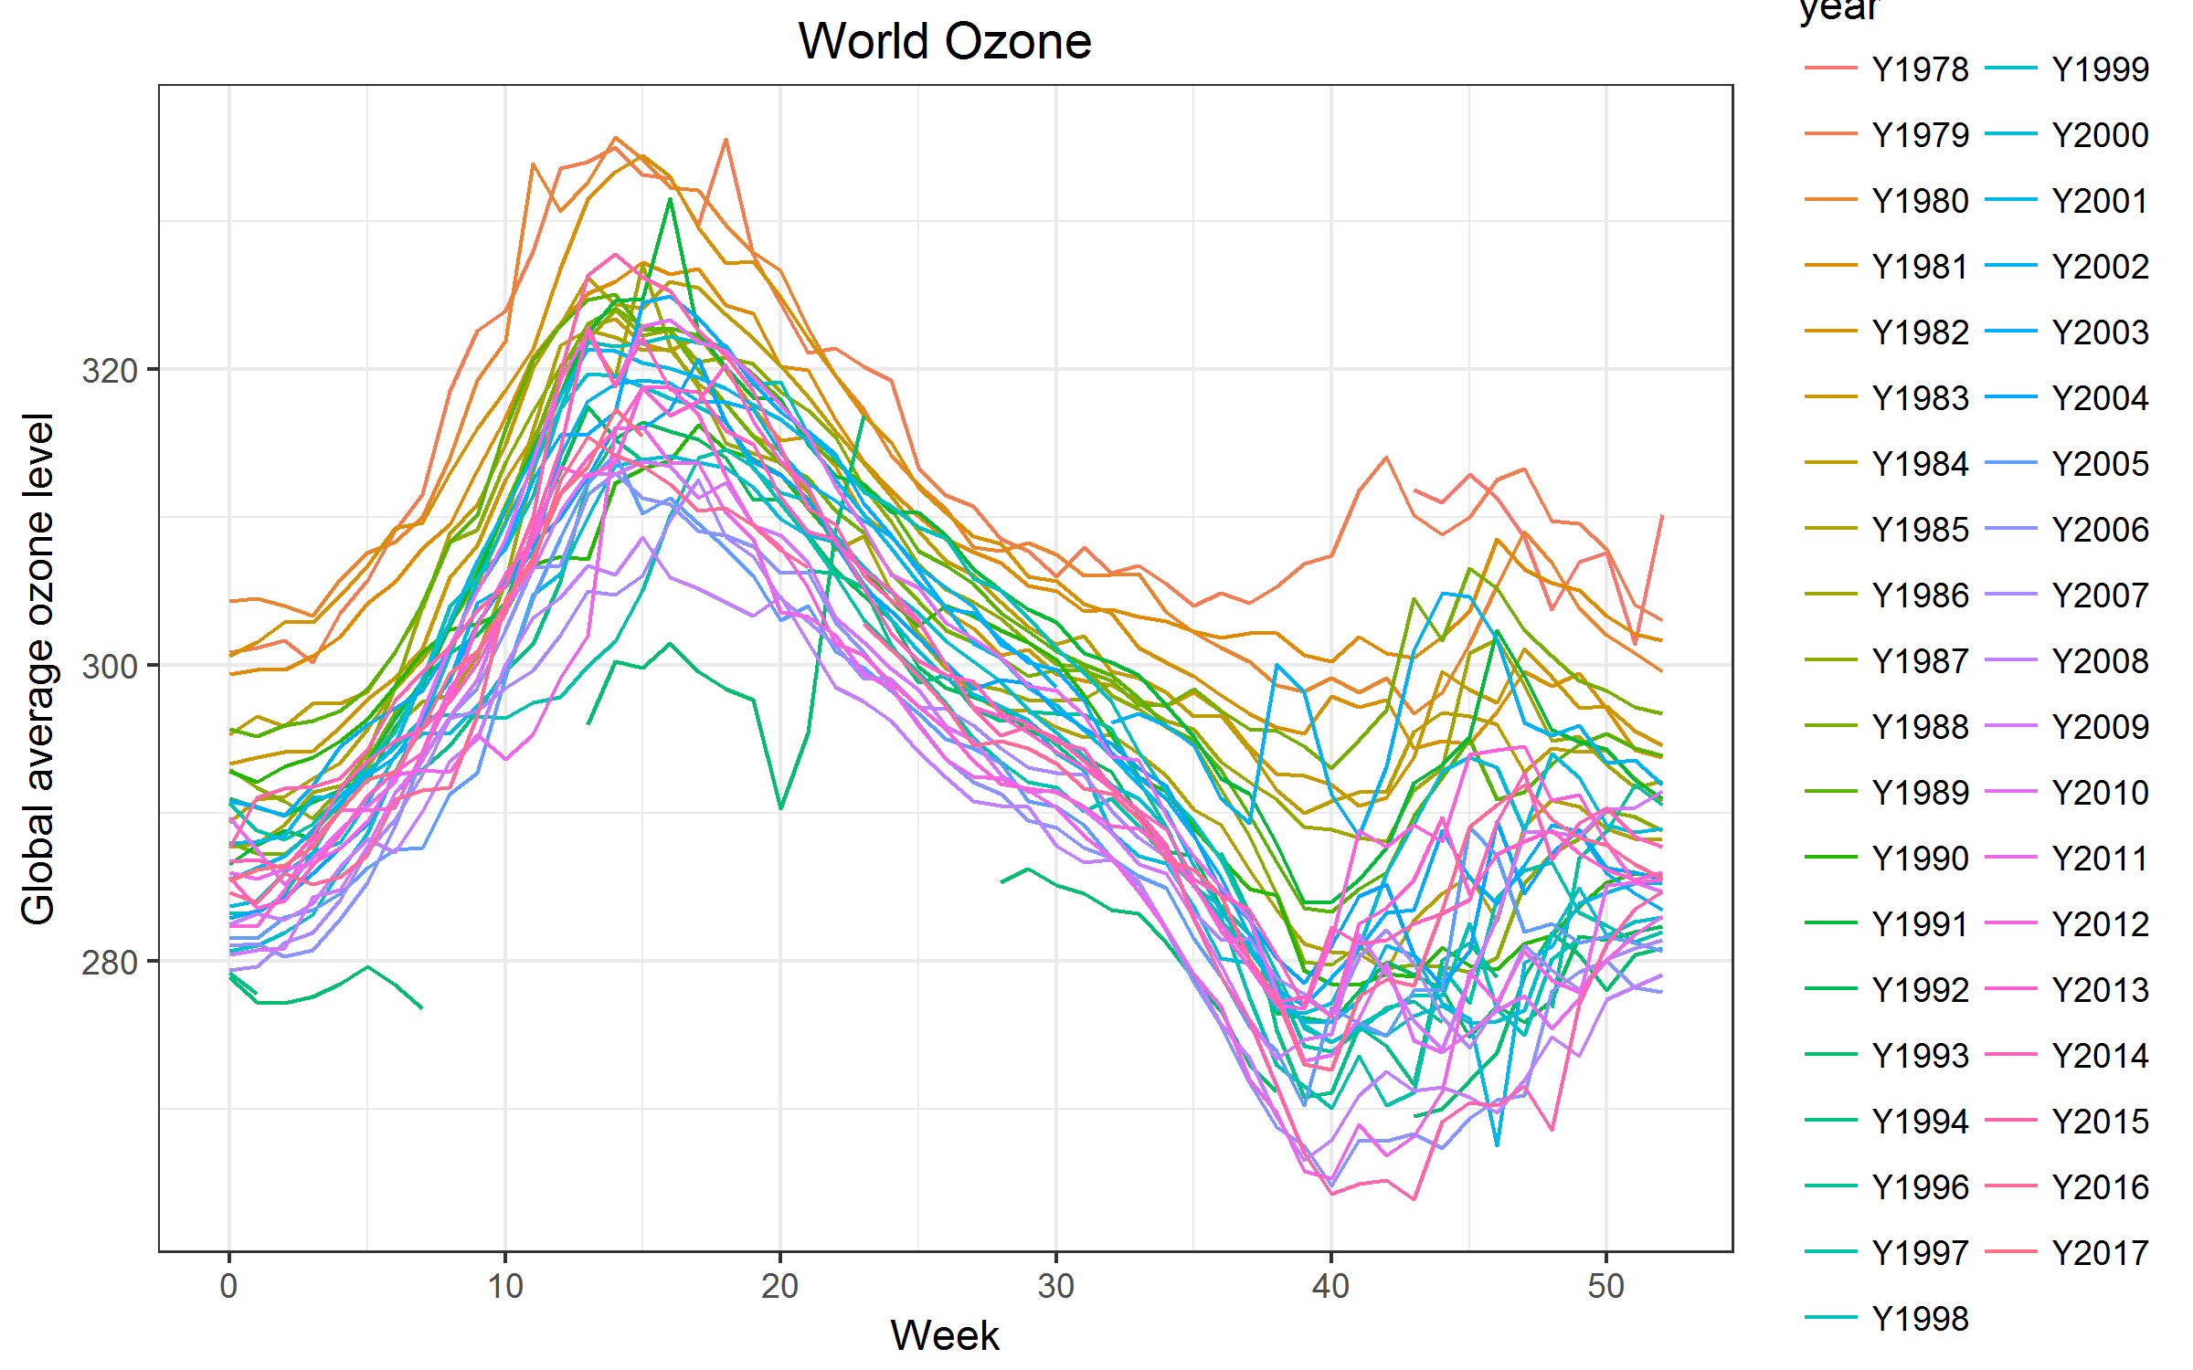
Clean Ozone Data
Data is daily grid (1978-2017)
288 by 180 (1.25 degree longitude and 1 degree latitude)
360 by 180 (1 degree longitude and 1 degree latitude)
Each year is divided to 53 weeks
Missing Data is prevalent (0 in raw data)
Weekly average of global Ozone level were taken
Notes:
1995 is missing
Ozone level is decreasing

Slide 11
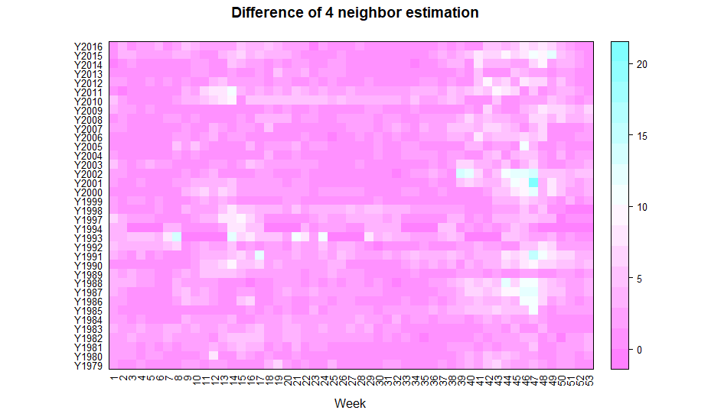
Clean Ozone Data (Cont.)
Get rid of years with more than 20 weeks missing
1996 and 2017 were excluded
The rest missing data were imputed using mean from neighbor data
Subtract all ozone data by the first weeks value
Reduce correlations

Slide 12
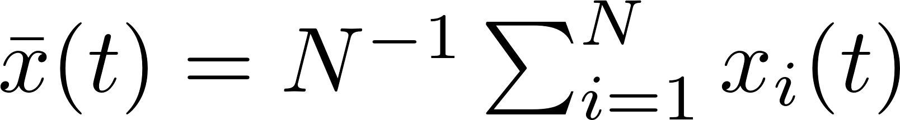
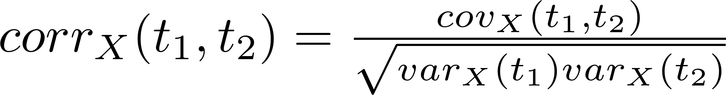
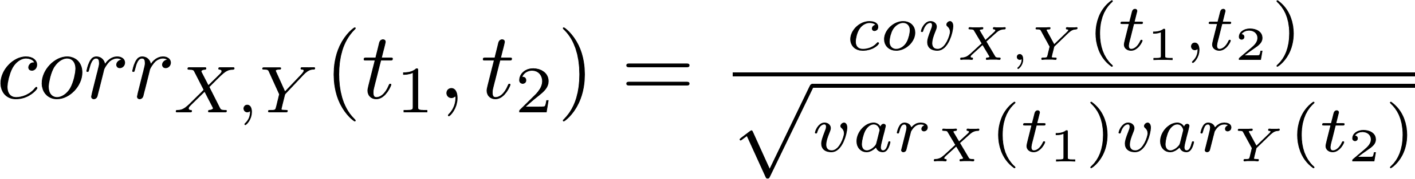
FD Representation
Mean
Variance
Covariance
Correlation
Cross-covariance
Cross-correlation
Notes:
Compare to multivariate analysis

Slide 13
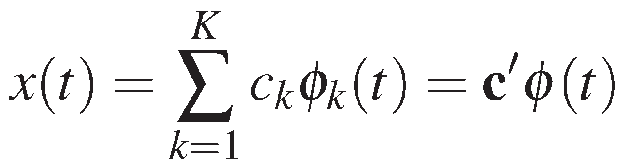
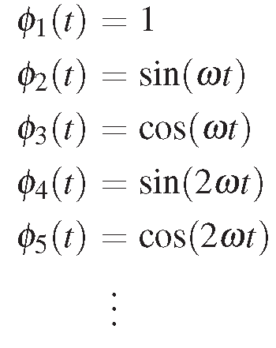

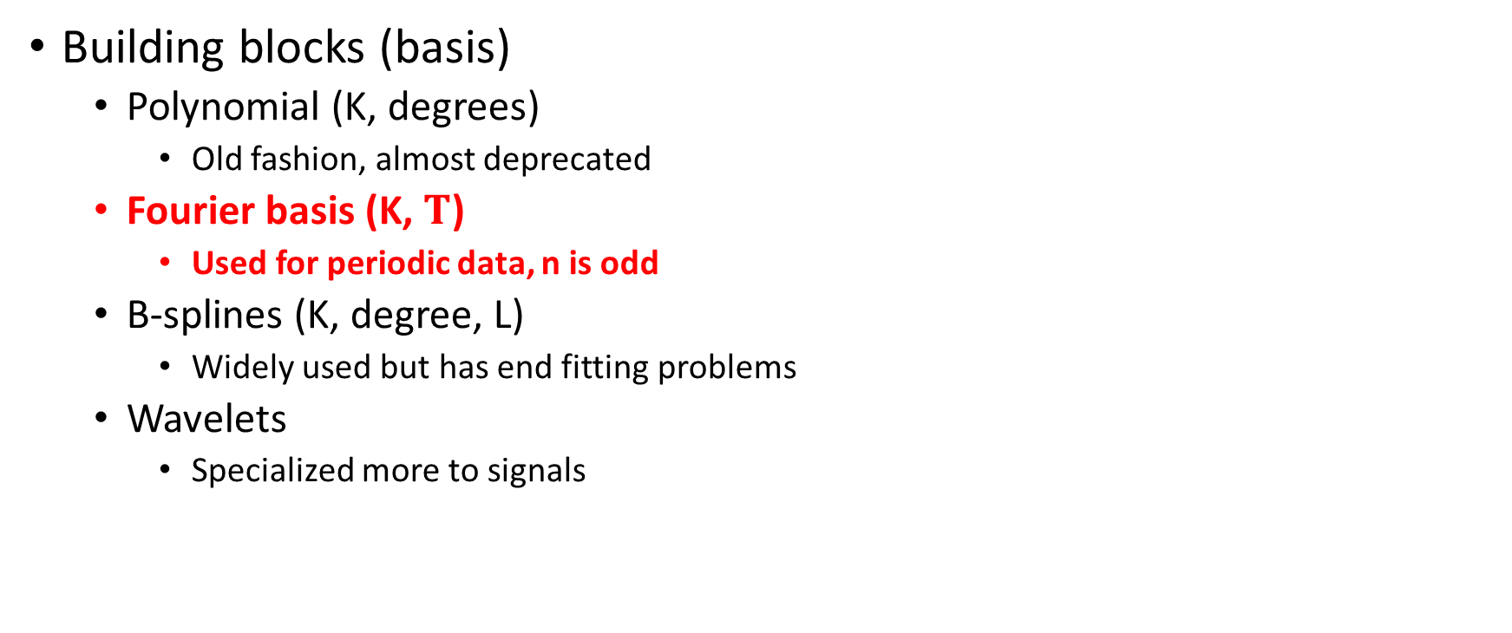
Smoothing Ozone data
Building blocks (basis)
Polynomial (K, degrees)
Old fashion, almost deprecated
Fourier basis (K, $T$)
Used for periodic data, n is odd
B-splines (K, degree, L)
Widely used but has end fitting problems
Wavelets
Specialized more to signals
Notes:
Wavelets base functions are modeling oscillations starts with 0 var and end with 0 var

Slide 14
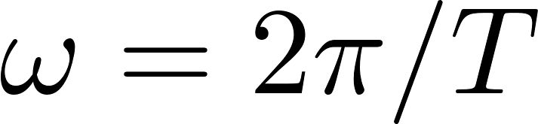
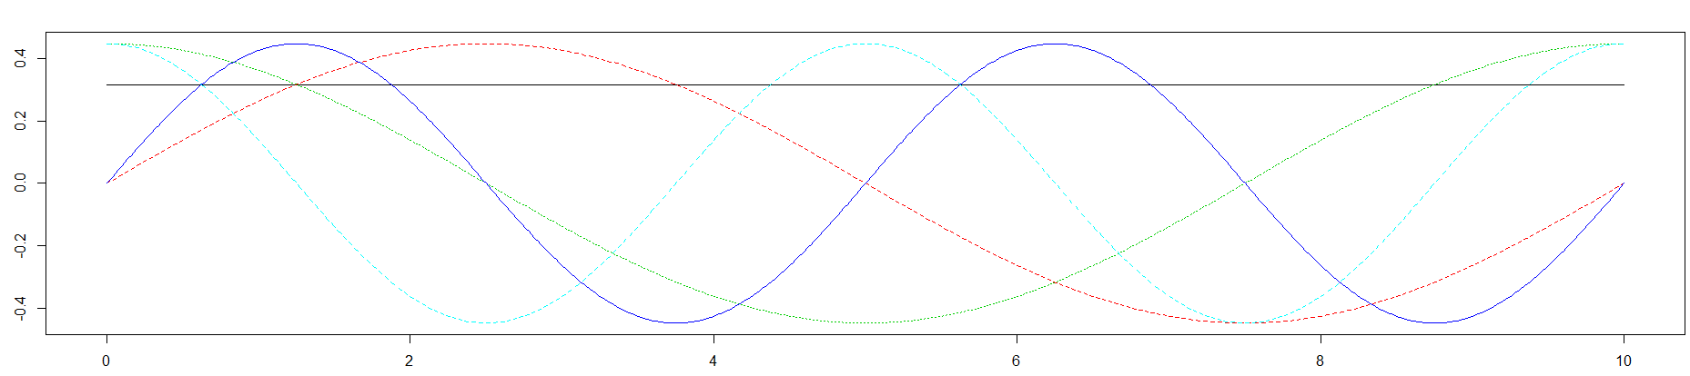
Fourier Basis System: Perfect for Ozone
Mainly used by periodic data
Does not have end fitting problems
Define K and ω
K needs to be odd
Basis are orthogonal
T is usually default to range(t)
Notes:
By default in R, c0 = 1/sqrt(T), c1~ck = sqrt(2/T) to make sure they are orthogonal

Slide 15
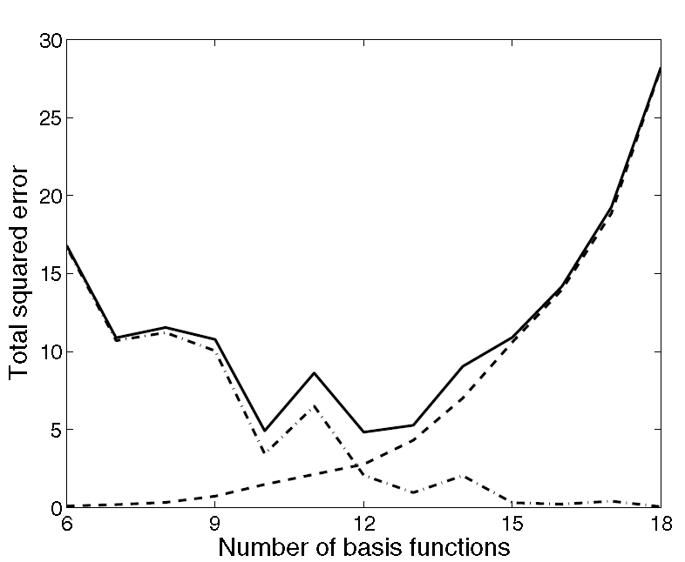
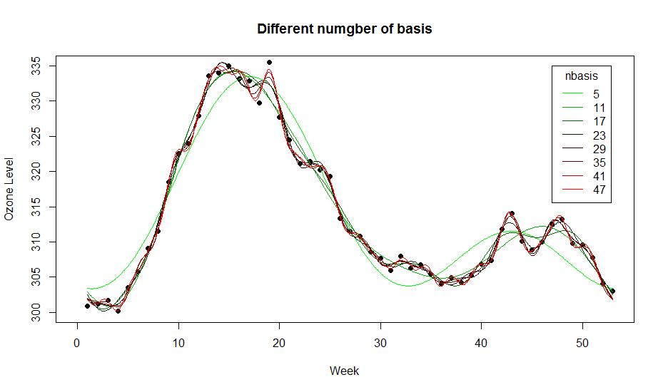
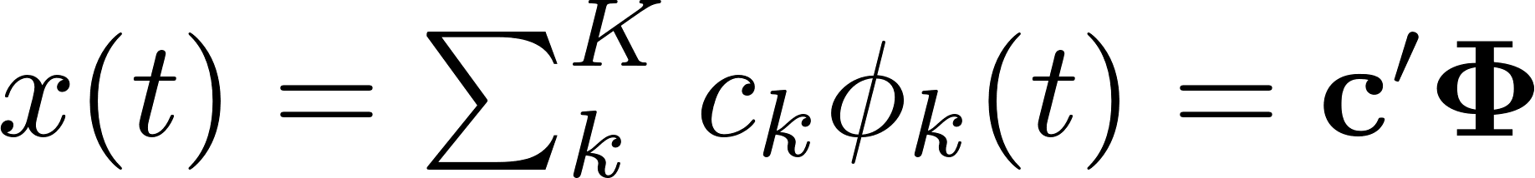
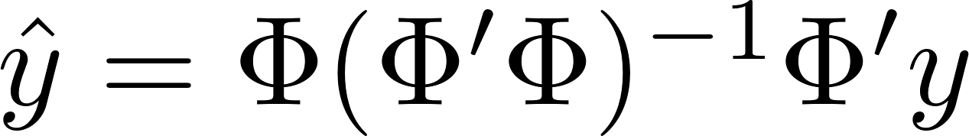
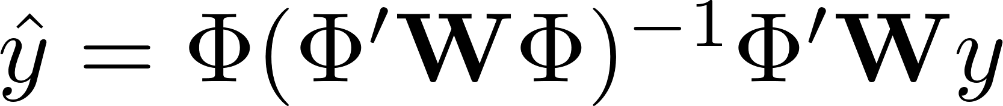
Smoothing
Important question: How many basis functions to choose?
Fit
More basis functions means better fit but ‘rougher’
Less basis functions means worse fit but ‘smoother’
Tradeoff between ‘bias’ and ‘variance’

Slide 16
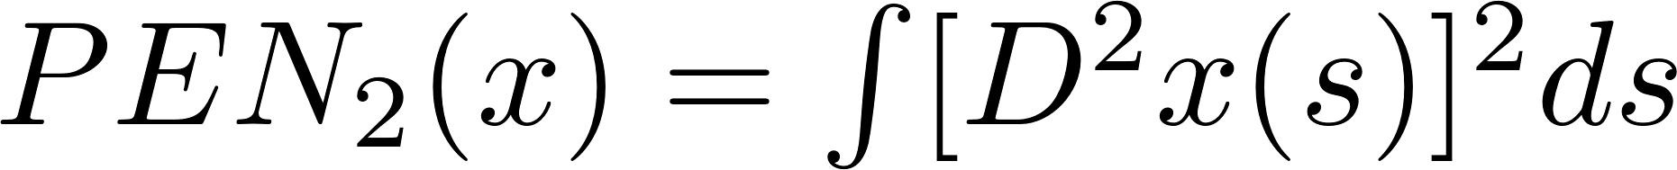
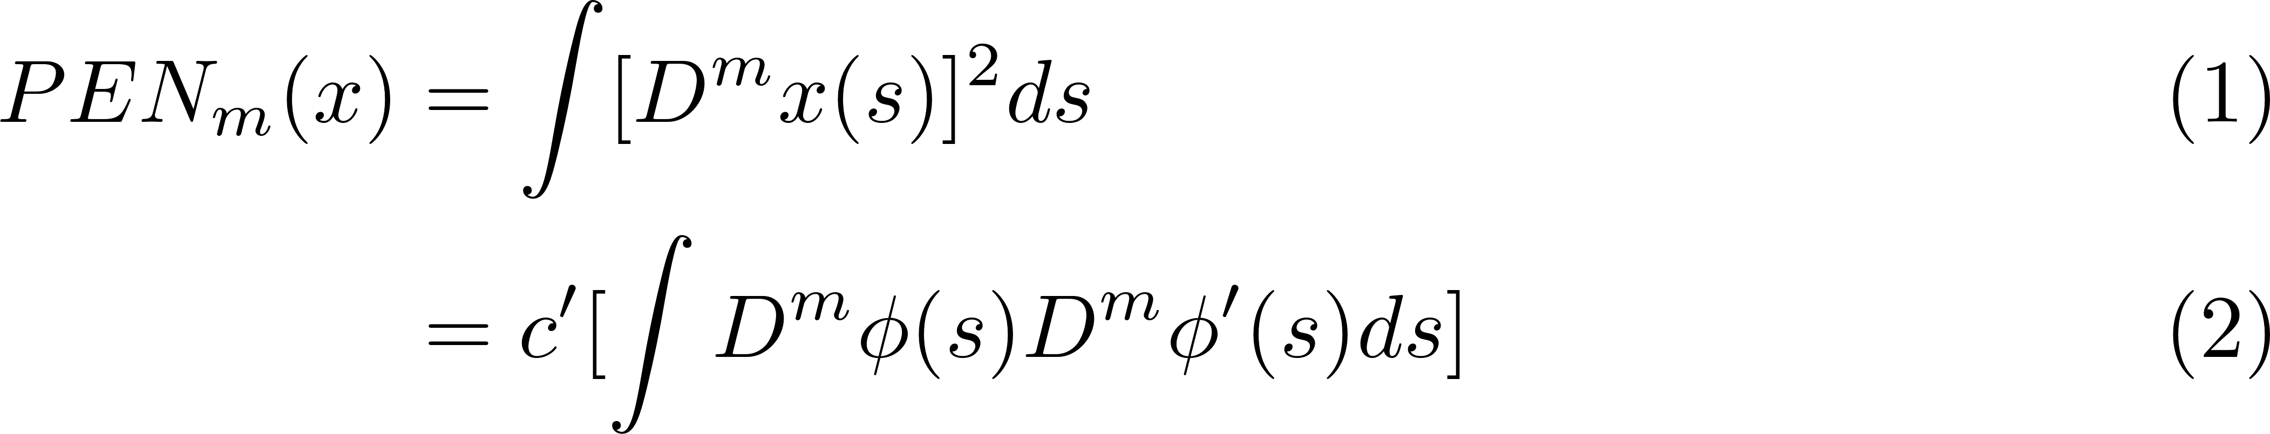
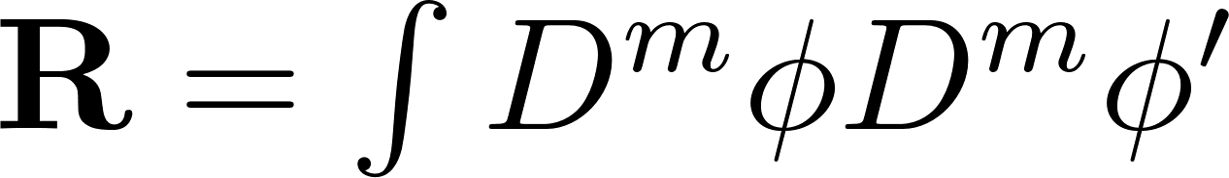
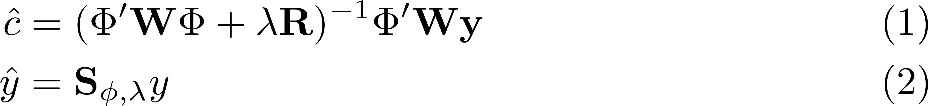
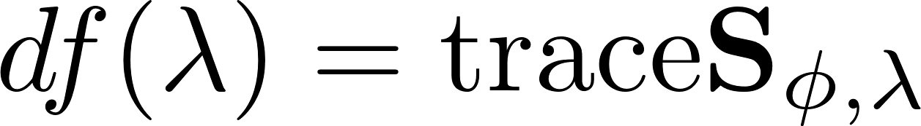
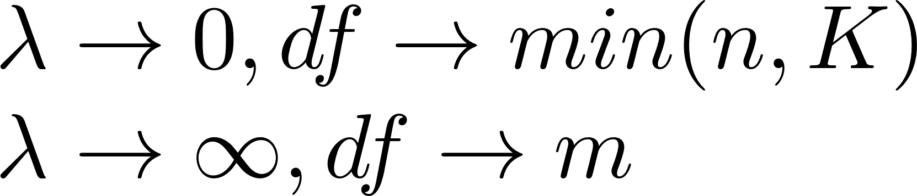
Smoothing with roughness penalty
Measure of roughness
Fitting criterion
So how to choose lambda?
c

Slide 17
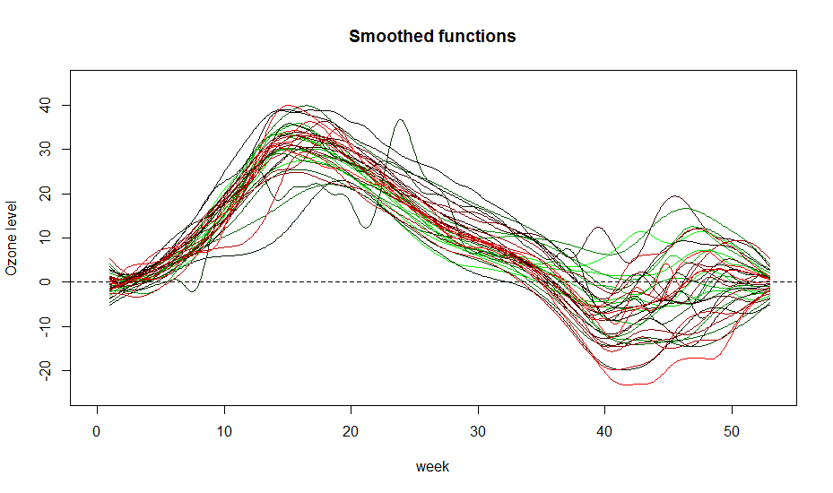
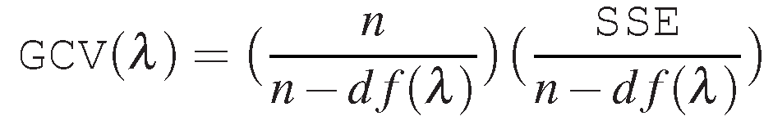
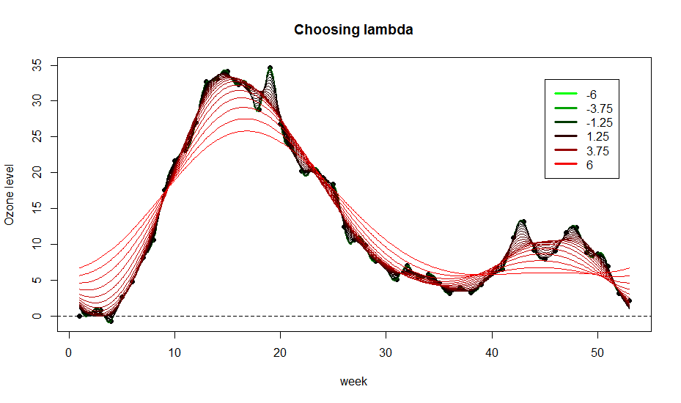
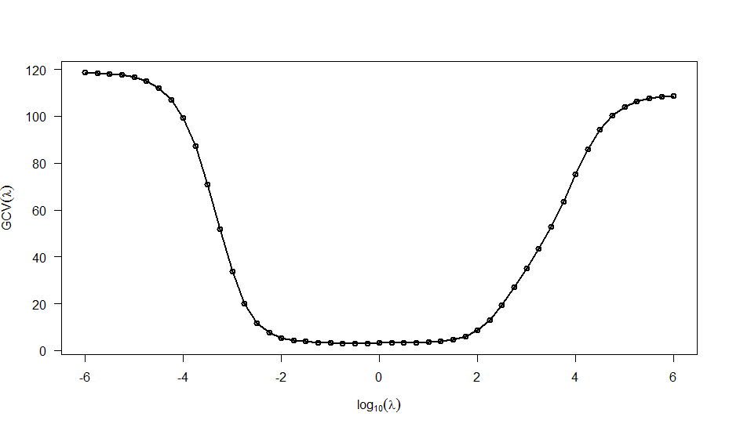
Choosing lambda by GCV
Defining GCV

Slide 18
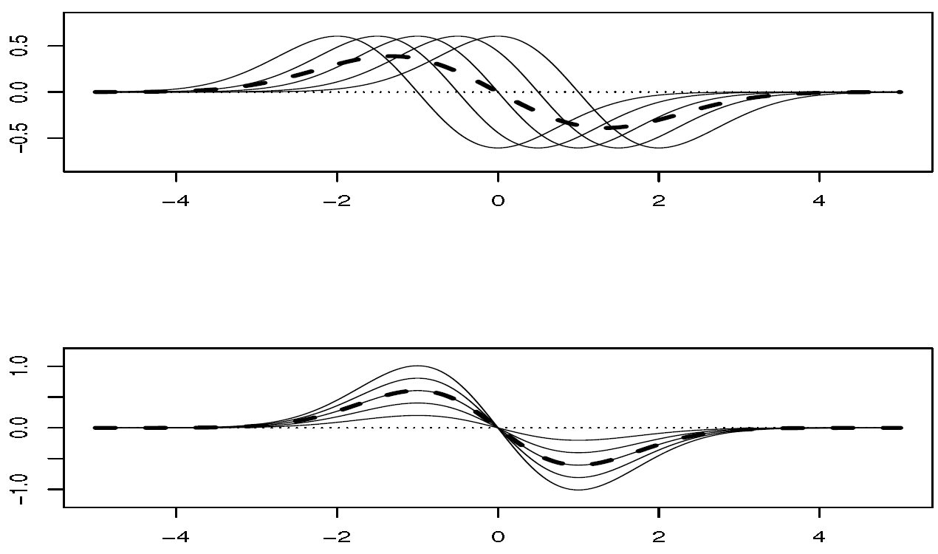
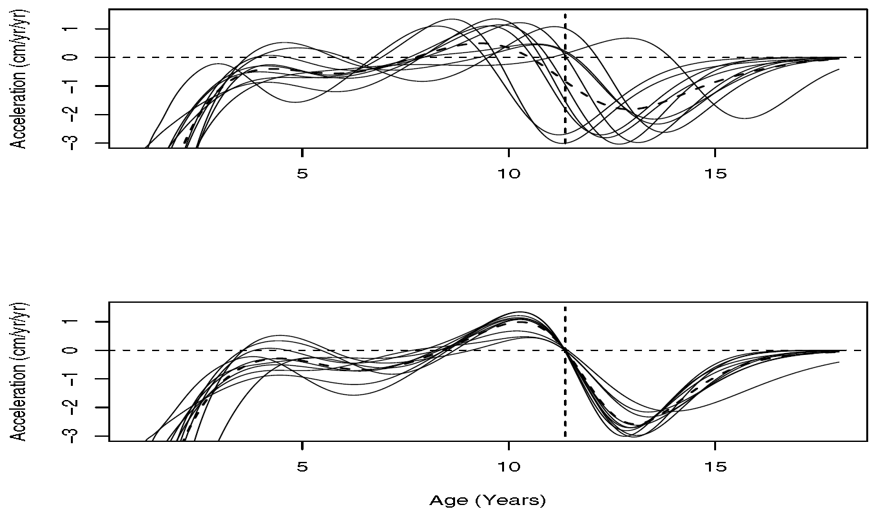
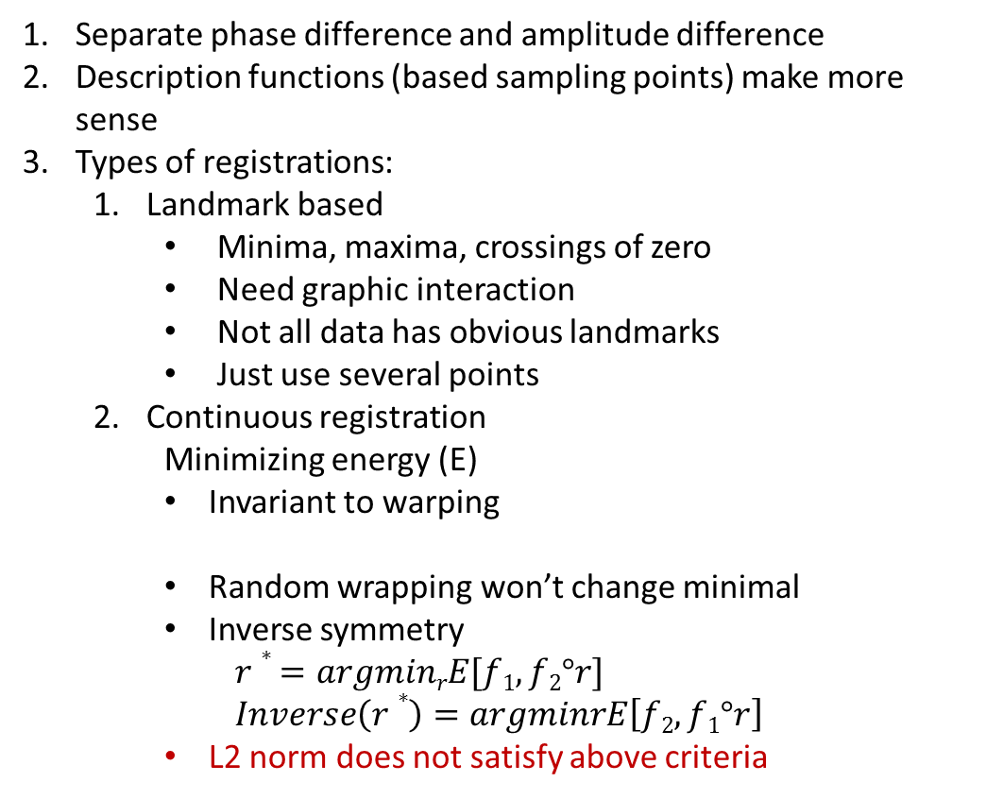
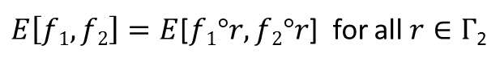
Registration by SRSF
Separate phase difference and amplitude difference
Description functions (based sampling points) make more sense
Types of registrations:
Landmark based
Minima, maxima, crossings of zero
Need graphic interaction
Not all data has obvious landmarks
Just use several points
Continuous registration
Minimizing energy (E)
Invariant to warping
Random wrapping won’t change minimal
Inverse symmetry
$$r∗ =argminrE[f1, f2°r]$$
$$Inverse\left(r∗\right)=argminrE\left[f2, f1°r\right]$$
L2 norm does not satisfy above criteria
$E\left[f1, f2\right]=E$[$f1°r, f2°r$] for all $r∈Γ$₂
Notes:
most statistical methods when translated into the functional domain are designed to model purely amplitude variation.

Slide 19
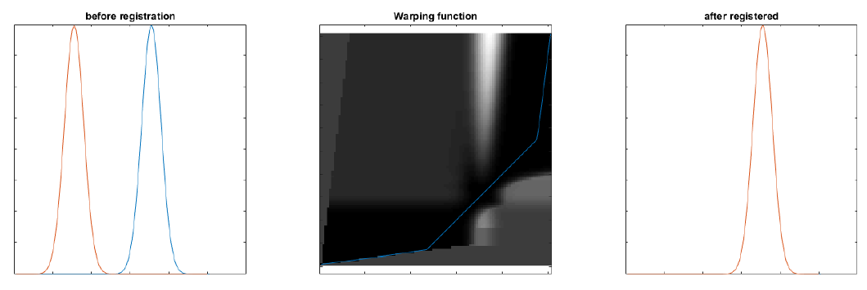
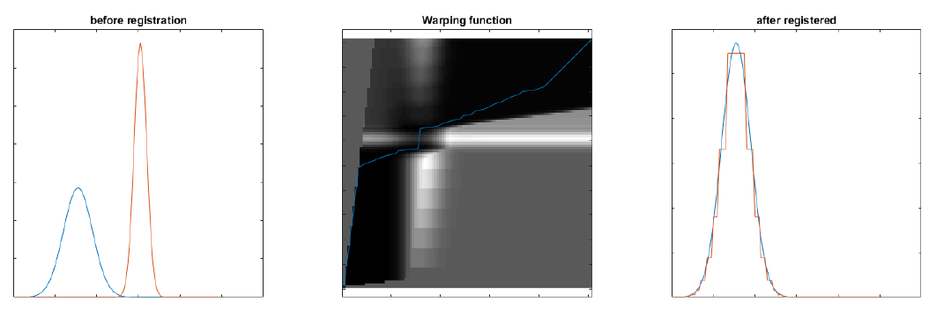
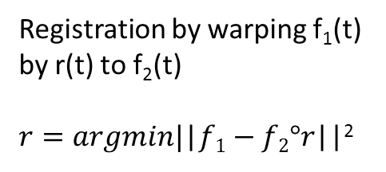
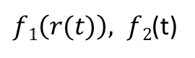
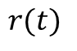
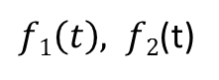
Warping function r
strictly increasing
Smooth (differentiable)
h(0) = 0 and h(T) = T
$f1\left(t\right), f2$(t)
$$r(t)$$
$f1\left(r(t)\right), f2$(t)
Registration by warping f₁(t) by r(t) to f₂(t)
$r=argmin|$|$f1−f2°r$||²
Pinching effect

Slide 20
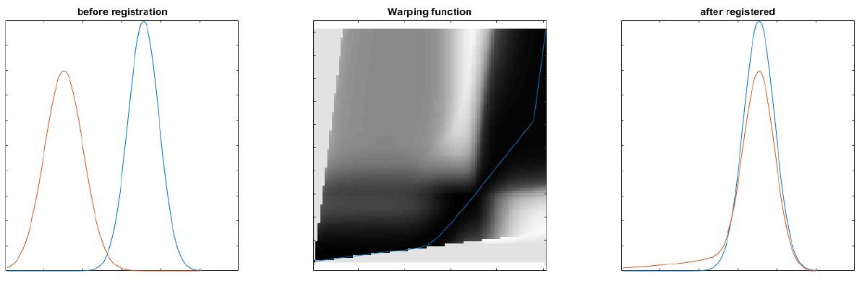
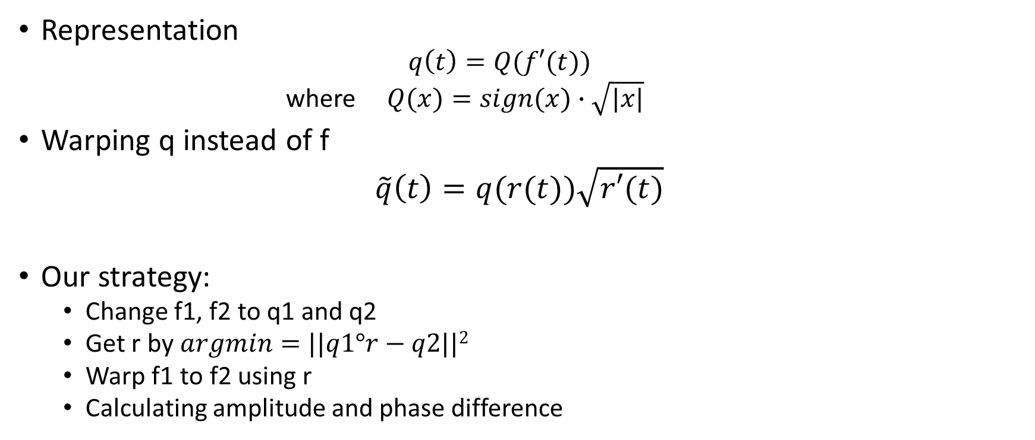
Square Root Slope Function (SRSF)
Representation
$$q\left(t\right)=Q(f′(t))$$
where $Q(x)=sign(x)∙\sqrt{|x|}$
Warping q instead of f
$\tilde{q}\left(t\right)=q(r(t))\sqrt{r′(t)}$
Our strategy:
Change f1, f2 to q1 and q2
Get r by $argmin=||q1°r−q2||2$
Warp f1 to f2 using r
Calculating amplitude and phase difference

Slide 21
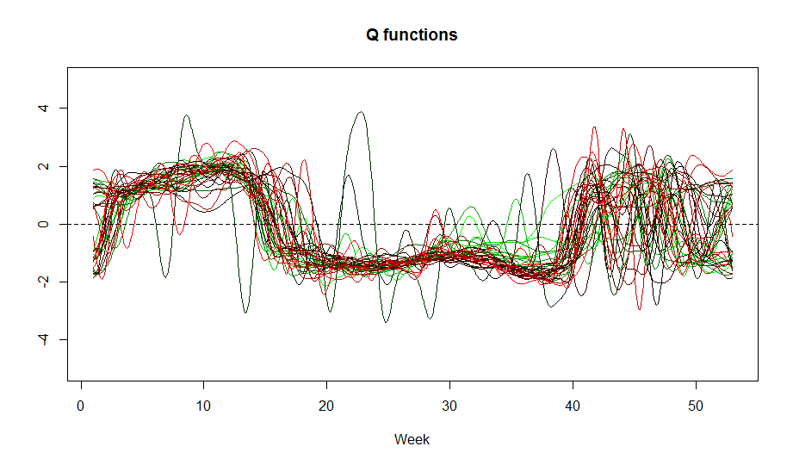
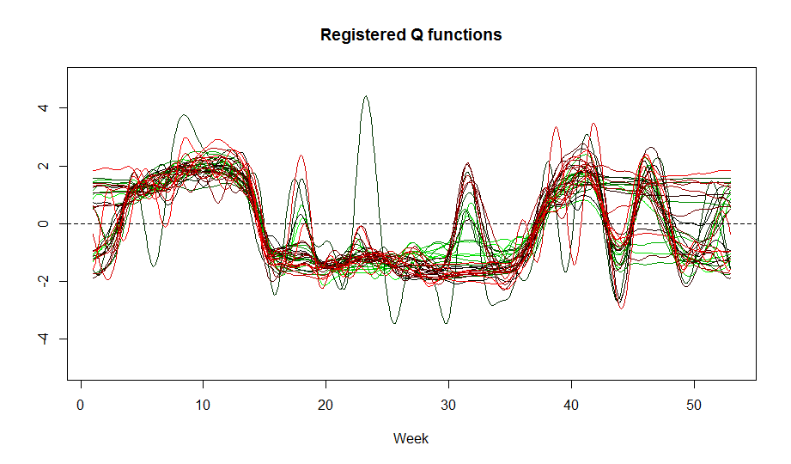
Registering Ozone data
Convert smoothed ozone data to SRSF representation Q
Register all Qs to the first one by Dynamic programming

Slide 22
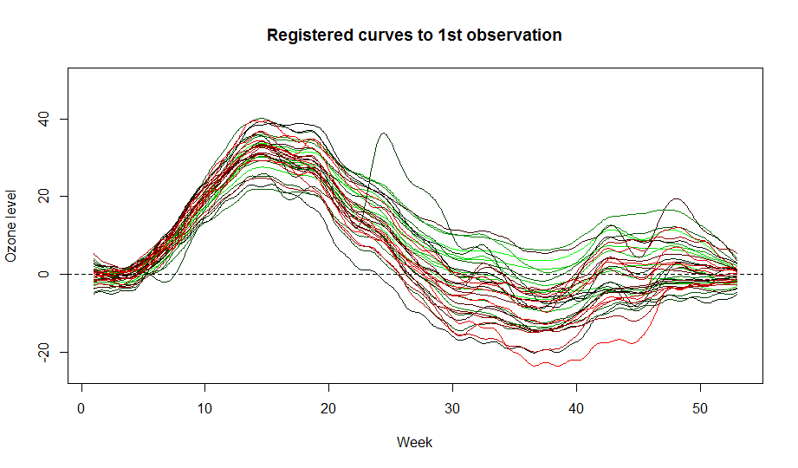
Registering Ozone data Cont.
Using the same warping function to warp smoothed Ozone functions

Slide 23
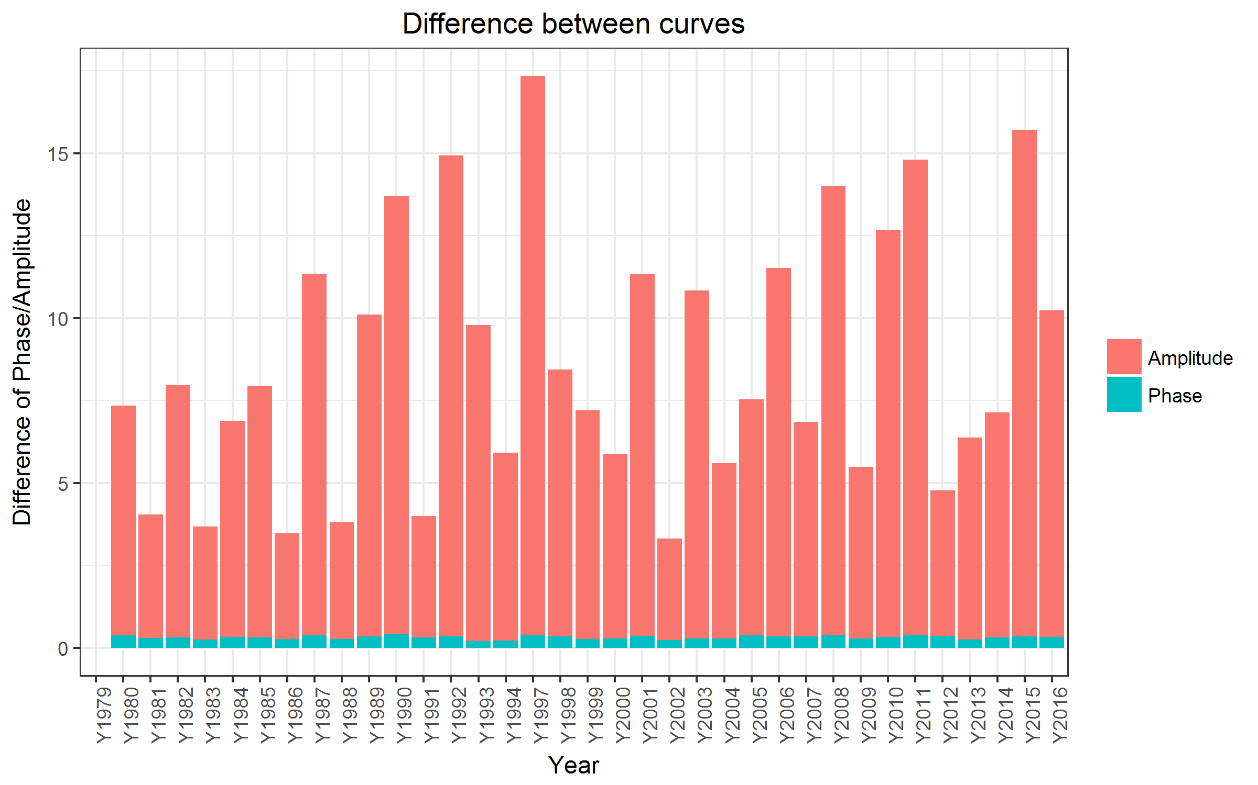


Compare amplitude and phase variations
Compute amplitude and phase variations as following
Da:
Dp:
Notes:
Da is a metric:
Symmetric
Positive definite
Triangle inequality

Slide 24






Descriptive Statistics
Mean Curve
Variance-Covariance surface
Notes:
Mean: increase rapidly in the first 15 weeks of a year and drop quickly to reach minimum at around 38 week and then rise back to value of beginning of the year
VarCov: variation showed typical time series characteristics.
very low in the beginning of the year due to subtracting the start number of ozone level. So it is increasing, but we do see a big jumper at around 20 week and two spikes at around 30 week and end of the year. So the most variable period of the global ozone is after 20 week of the year and especially around 30 week and 43 week

Slide 25





Functional Principal Components Analysis
An intuitive transition from multivariate analysis
First $ℓ$ eigen functions are ‘most efficient’ for approx. original function
Eigen function
Eigen value
Notes:
Ci is

Slide 26


Visualize FPC

Slide 27

Approx. 1978 Ozone level by FPCA
Change the way to present?

Slide 28

Notes:
Scores were ploted

Slide 29


Regression
Build design matrix
Functional Response:
Registered, smoothed Ozone data
Scalar Covariates:
Annual temperature
Annual precipitation
Annual CO₂ emission
……
Notes:
1995 and 1996 are missing
Design matrix is in list form

Slide 30




Smoothing Selection (Changing number of basis)
Model selection focusing how to choose basis for $β$
First we try different basis without penalty
LOO CV showed the best number of basis is 41 with CV error 979.6247

Slide 31


Smoothing Selection (Changing $λ$)
As expected, lambda won’t help in our case
Theoretically, more basis functions for beta has nothing to do with df as in the scalar response model.
So the more basis, or less lambda, the better fit we would get, just like we should.
However, because in reality, more basis function might cause instability of computation. So According to our CV, we pick 41 Fourier basis and no roughness penalty
Notes:
The combination of a high-dimensional
basis with a roughness penalty reduces the possibilities that either
Important features are missed
extraneous features are forced into the image by using a basis set that is too small for the application.

Slide 32

Fit the Model
Notes:
Intercept:
Ozone increase from 8th week and reach max around 20 to 35 week, then drop to lowest point at 46 week and increase to another peak at 49 week and drop back to baseline
Temperature:
High temp would increase ozone level from 0 to 23 week and from 35 to 53 week. But lower ozone from 24 to 35 week a little
CO2:
High CO2 is lowering the Ozone level throughout the year, but most dramatic from 30 to 43 week
Precipitation:
High precipitation is associated with lower ozone especially from 9 to 44 week,

Slide 33



Assessing fitting
Comparing to mean only model

Slide 34


Confidence intervals of $β$’s
Notes:
Basically there is no significant effects just like the very low R2 is indicating. There might be weak association but never significant.

Slide 35



Permutation test
P value (max(F)): 0.385
Obs max(F): 0.272

Slide 36
Summary
Global average ozone is fluctuating along the time of each year
The fluctuation is not shifted a lot between years
Major difference among years occurs later in the year
First PC summarize variance between 38 to 48 week
Covariates don’t explain significant portion of the variance
Our regression model is not significant

Slide 37
Reference
FDA with R and MATLAB, Ramsay, James O., Hooker, Giles, Graves, Spencer
Functional and Shape Data Analysis, Anuj Srivastava, Eric P Klassen
Functional Data Analysis of Amplitude and Phase Variation, J. S. Marron, James O. Ramsay, Laura M. Sangalli and Anuj Srivastava, Statistical Science, 2015, Vol. 30, No. 4, 468–484
STAT5376 Course notes, Dr. Su

Slide 38
Thank you for your attention!

